Slide 1
RED BEE MEDIA GENDER PAY GAP
APRIL 2022

Slide 2
OUR COMMITMENT TO ENSURING QUALITY
Red Bee Media is part of the Ericsson Group.
At Ericsson we believe that diverse, inclusive teams drive performance and innovation, creating greater business value and we therefore consider and create diversity & inclusion in everything we do.
We are committed to equal opportunity in employment, development, compensation and all other people actions without discrimination due to race, colour, gender or sexual orientation.
We strive for inclusion where we treasure diversity and build communities of engaged employees. As a key part of this strategy, we focus on supporting, mentoring and developing women. We continually aim to improve the gender mix at all levels of the company.
25%
32%
20%
25%
Women in Ericsson Globally
Women in Ericsson’s Executive Leadership Team
Women on Ericsson’s Board
Women in Line Manager Positions

Slide 3
RED BEE MEDIA IN NUMBERS APRIL 2022
Red Bee Media’s business is to provide high quality media experiences for our customers’ audiences.
This data is relevant to April 2022 where in the UK 31.4% of our employees were female at this time.
We continue to see improvements in closing our gender pay gap with a mean gap of 12.5% down from 15.5% in 2021 and 19.3% in 2019. This improvement is also reflected in our median gap at 15.7% down from 18.2% in 2021.
The bonus pay gap closed, significantly improving from 26% in 2021 to -22.2%, as the average female bonus was higher than for males, due to females in more senior roles receiving a bonus. The significant improvement is also reflected in the median bonus pay gap reducing to 7.9% from 46.4%.
Although there is significant increase in the proportion of females
in upper middle quartile (+3.9%), in 2022 a higher proportion of
males received a bonus in general, although many were low in value.
Male
Lower quartile
Female
Upper quartile
Upper middle quartile
Lower middle quartile
2022 Gender Pay Gap
12.5 % | 15.7% | -22.2% | 7.9% | 32.7% | 21.3%
(15.5%) | (18.2%) | (26.0%) | (46.4%) | (16.3%) | (14.2%)
Gender pay gap mean | Gender pay gap median | Bonus pay gap mean | Bonus pay gap median | Males receiving bonus | Females receiving bonus
(2021 Gender Pay Gap shown in brackets)

Slide 4
COMMITTED TO CLOSING THE PAY GAP
Red Bee Media continues to be wholly committed to increasing its female workforce within the UK and closing the gap in gender pay, particularly focusing on increasing the number of women in medium to senior roles.
We continue to focus on ways in which to attract and retain women in Red Bee Media and developing into more senior roles, with the aim of increasing the number of women in our workforce. We are implementing a series of ongoing initiatives such as:
We have in place an established Global Red Bee Media Diversity & Inclusion Forum where we have representatives by market area and organisation and have established and communicate ongoing tasks and activities.
Refocused approach to recruitment to ensure more inclusive and recruitment pools include more women and diverse candidates.
Increased proportion of women going through leadership training, including a specific career management programme designed to address the unique barriers women face in progressing their careers.
Signed up for RISE accreditation programme and continuation of sponsorship supporting gender diversity across the media technology sector.
Introduced an intern and graduate training programmes, with the aim of 50:50 gender balance.
Created a more formalized approach to Secondment opportunities .
We continue to closely review gender pay and make any adjustments where necessary if any inequity.
Our ambition is to continue to have an improved gender-balanced workforce at all levels in the organisation, continuing to reduce the gender pay gap.

Slide 5
Ericsson UK Ltd in numbers to April 2022
Ericsson UK Ltd represents Ericsson’s core network business in the UK, during 2021 to April 2022:
We have seen a change in our gender pay gap with a mean gap of -1.3% down from 0.2% in 2021. With the median pay gap now at -3.6%.
We continue to see an decrease in our bonus pay gaps from 5.2% to 3.8% while the median bonus gap increases to 13.1% from 7.4% in 2021. The percentage of female employees in the upper pay quartile continues to improve increasing by 3.4% in 2022, from an increase of 1.9 in 2021.
Gender split by pay quartiles
Female
Male
Upper Quartile
Upper Middle Quartile
Lower Middle Quartile
Lower Quartile
2022 Gender Pay Gap
-1.3 % | -3.6% |  | 3.8 % | 13.1 % |  | 99.5 % | 98.1 %
(0.2%) | (-4.0%) |  | (5.2%) | (7.4%) |  | (94.2%) | (89.6%)
Gender pay gap mean | Gender pay gap median |  | Bonus pay gap mean | Bonus pay gap median |  | Males receiving bonus | Females receiving bonus
(2021 Gender Pay Gap shown in brackets)

Slide 6
We’re committed to close the gap and keep it closed
We are placing a significant focus on attracting and retaining female talent with the aim of increasing our female workforce distribution at all levels in Ericsson UK.
We have launched a wide program to address our gaps which has resulted in a strong improvements over the last 4 years.
Ericsson is committed to closing the gap in gender pay in the UK.
Some of our UK initiatives
Speaker events driven by our Women’s Network from influential women within Ericsson and externally.
STEAM mentoring programme with college and schools students
Supporting & celebrating International Women’s Day through onsite events and learning.
Continuing initiative to attract women into the UK organisation, appointing a further 40 females between April 2021 and April 2022 (31% of all new hires during this timeframe)

Slide 7
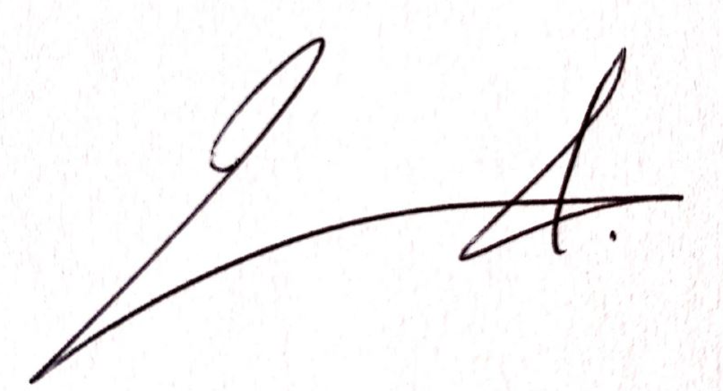
Approved by:
James Arnold CEO
Red Bee Media

